Slide 1


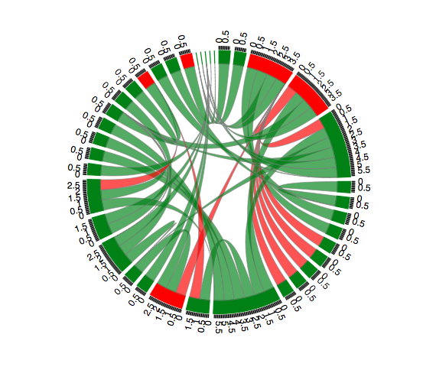





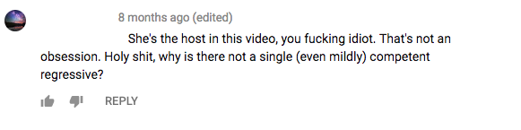
Who Will Reply to A Troll? A Network Approach to Understanding Trolls in Online Communities
Qiusi (Lyra) Sun & Cuihua (Cindy) Shen
qssun@ucdavis.edu cuishen@ucdavis.edu
Department of Communication, University of California, Davis
Introduction
Trolling behavior is viewed as aggressive behavior with the intention to disrupt the discussion and displease other users, and it usually manifests as providing fallacy regarding of the topic in-discussed, making snap judgment of other users or attacking people, and using profanity.
Social network metrics provides information that is not only about the community structure but also about individuals’ involvement, devotion and attachment, which help to construct and reinforce individuals’ social identity.
From people who they share the same social identity, individuals learn social norms and normative behaviors, which guide their own behavior in the community.
Network metrics of a discussion community provides a useful approach to understand members’ social identity and how they react to to trolls.
Hypotheses
H1: Individuals with higher centrality are more likely to respond to trolls.
H2: Individuals in a more dense network are more likely to respond to trolls.
H3: individuals who have higher activeness are more likely to respond to trolls.
H4: The more previous response to a troll/ trolls in a community, the more likely an individual will respond to the troll/ trolls in the community.
H5: An individual is more likely to respond to a troll/ trolls in a community, if other community members who they have interacted with responded to the troll/ trolls in the community.
H6: The more community members response to a troll/ trolls in the community, the more likely an individual in the community response to the troll/ trolls.
H7: Troll post with higher negativity are more likely to provoke responses.
Methods
Samples
Top 3 political channels (TYT, CNN and BBC news)
Top 3 comedy channels (College Humor, Annoying Orange, and PowerfulJRE)
23 video communities were selected with a history of a month, more than 1000 comments and the videos need to be last about 4 to 10 minutes to provide adequate information for potential discussions.
An example of selected videos and comments
Trolling messages were identified from all comments about the videos, using vulgarity list, second person pronoun and the sentiment.
Examples of trolling comments
Pre-troll social networks were captured for the first 5 trolls in a community from comment structure.
An example of pre-troll social networks
Mixed effect hierarchy logistic regressions were used in the study.
Results
Logistic Regression Models Predicting the Likelihood of Response to Troll
Poisson Regression Models Predicting the Frequency of Response to Trolls
Conclusion
Individuals who are more central in a community are more likely to be provoked by trolling behaviors.
Members of dense network tend to respond to trolls.
The tendency of responding to trolls are not associated with individuals’ activeness.
When there are a lot of records of responding to trolls in the community history, individuals tend to respond to trolls as well, whereas the record of responding to a certain single troll doesn’t have the same effect.
Whether individuals interact with people who respond to trolls is not associated with the tendency of responding.
Cumulatively, individuals tend to respond to trolls if there are more responses to trolls in the community. And the result stay the same for a certain single troll.
The more negative a troll post is, the more likely the post will receive response.
 |  | model 3 |  |  |  | model 4
variable |  | B |  | SD | z | B |  | SD | z
Indegree |  | 0.030 |  | 0.484 | 0.06 | 0.290 |  | 0.639 | 0.45
Outdegree |  | -1.599 | ** | 0.545 | -2.94 | -2.406 | *** | 0.726 | -3.32
Cumulative response |  | -0.280 |  | 0.394 | -0.71
Previous response |  | 0.362 |  | 0.335 | 1.08
Cumulative response in community |  |  |  |  |  | 2.665 | * | 1.282 | 2.08
Previous response in community |  |  |  |  |  | -0.107 |  | 0.252 | -0.42
interaction with response members in community |  |  |  |  |  | 1.651 |  | 1.342 | 1.23
Negativity |  | -0.481 |  | 1.308 | -0.37 | -0.744 |  | 1.136 | -0.66
Activeness |  | 2.142 | *** | 0.258 | 8.32 | 2.569 | *** | 0.382 | 6.73
Network size |  | 0.014 |  | 0.022 | 0.64 | 0.025 |  | 0.023 | 1.06
Density residual |  | 0.094 |  | 0.108 | 0.88 | 0.076 |  | 0.108 | 0.70
Model AIC |  | 95.8 |  |  |  | 91.6
‘***’ 0.001 ‘**’ 0.01 ‘*’ 0.05 ‘.’ 0.1 ‘ ’1
 |  | model 1 |  |  |  | model 2
variable |  | B |  | SD | OR | B |  | SD | OR
Outdegree |  | 0.518 | ** | 0.173 | 1.679 | 0.515 | ** | 0.159 | 1.673
Indegree |  | -0.605 | ** | 0.197 | 0.546 | -0.648 | ** | 0.212 | 0.523
Cumulative response |  | 1.921 | *** | 0.200 | 6.828
Previous response |  | -0.310 | . | 0.169 | 0.733
interaction with response members |  | -14.632 |  | 362.039 | 0.000
Cumlative response in community |  |  |  |  |  | 1.048 | *** | 0.190 | 2.851
Previous response in community |  |  |  |  |  | 0.332 | ** | 0.116 | 1.394
Interaction with response members in community |  |  |  |  |  | 0.514 |  | 0.334 | 1.671
Negativity |  | 1.079 |  | 0.971 | 2.940 | 2.797 | ** | 0.858 | 16.401
Activeness |  | 0.451 |  | 0.320 | 1.570 | 0.428 | . | 0.260 | 1.534
Network size |  | -0.038 | ** | 0.012 | 0.963 | -0.064 | *** | 0.011 | 0.938
Density residual |  | 0.190 | * | 0.078 | 1.209 | 0.084 |  | 0.063 | 1.088
Model AIC |  | 422.4 |  |  |  | 610.2
‘***’ 0.001 ‘**’ 0.01 ‘*’ 0.05 ‘.’ 0.1 ‘ ’ 1

